Slide 1

Testing of Controls
By Ludovicus Sensi Wondabio

Slide 2

Definition of Test of Control
Auditing procedures performed to determine the effectiveness of the design and/or operations of control policies and procedures in support of a reduced assessed control risk.

Slide 3
AGENDA TRAINING
Refresh previous training session
Design, Perform & Evaluate Test of Control
Auditing in Information System Environment

Slide 4
Refresh Previous Training Session
Internal Control Components
Control Environment
Risk
Assessment
Control
Activities
Information and
Communication
Monitoring

Slide 5
TOC Steps
Obtain and Document Understanding of Internal Control
Assess Control risk
Design, Perform and Evaluate
Decide Planned Detection Risk and Substantive Tests
Communicate to those charged with governance
  SPAP: PSA No. 35
Today’s Topic
Notes:
Contoh WP 1500an

Slide 6
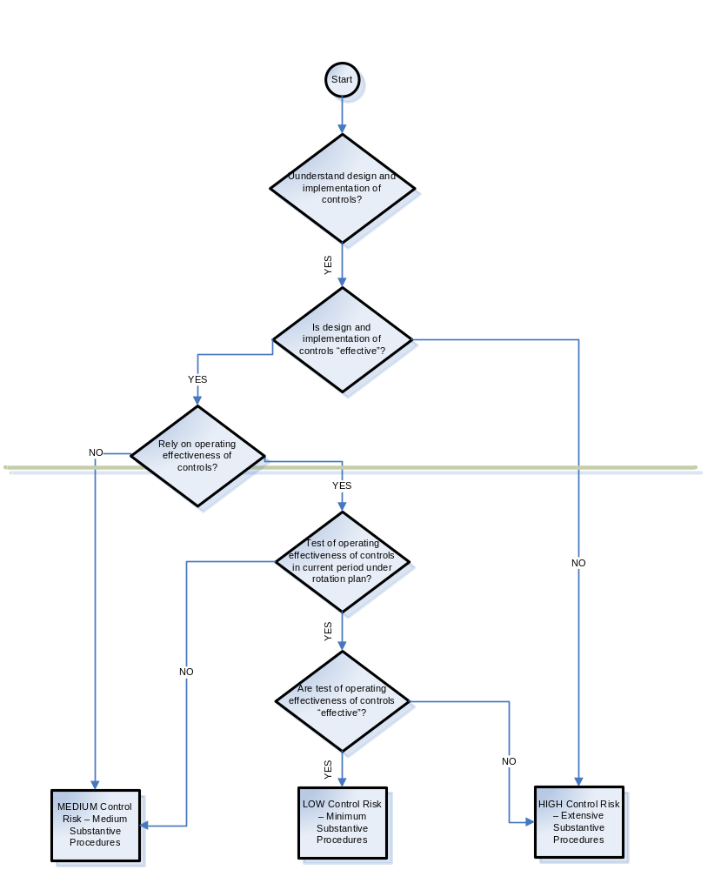
Notes:
Print 1 halaman sbg Lampiran 1

Slide 7
Question:
Jika pada saat preliminary (test design and implementation of internal control) auditor menyimpulkan bahwa internal control adalah efektif, apakah auditor harus melakukan tes operating effectiveness dari internal control tersebut ?

Slide 8
Methodology for Designing Controls and Substantive Tests
Understand internal
control
Assess
control
risk
Determine
extent
of testing
controls
Design tests of controls
and substantive tests
of transactions to meet
transaction-related
audit objectives
Audit procedures
Sample size
Items to select
Timing

Slide 9
Audit Evidence
Substantive
Assurance
Analytical Procedures
and Tests of
Details
Tests of
Controls
Risk Assessment at
the Account Balance
and Potential Error
Level
Inherent
Assurance
Control
Assurance
Notes:
Objective 5.2 continued.
Use the slide to further discuss the Audit Assurance Model.
We obtain audit assurance for each significant account balance from one or a combination of the following three sources:
Inherent assurance: We obtain inherent assurance from assessing risk at the account balance and potential error level. We obtain a maximum level of inherent assurance when we have not identified a specific risk, and no inherent assurance when we have identified a risk.
Control assurance: We obtain control assurance from identifying and testing controls that prevent or detect the potential error.
Substantive assurance: We obtain substantive assurance from performing substantive analytical procedures, tests of details, or a combination of the two. Our substantive procedures should be designed to detect the potential error if it has occurred and was not detected by the client’s controls. For each potential error, substantive assurance should constitute some portion of our audit assurance.
We combine the different types of assurance, as set out in the audit assurance model in statistical terms, so as to achieve a 95% level of overall assurance.
Ask participants how much assurance we seek in statistical terms?
In statistical terms we seek a level of 95% overall assurance. This equates to a 5% overall risk which is considered acceptable by the Firm.

Slide 10
Audit Risk Model for Planning
AR = DR x IR × CR
where:
AR = Audit risk
DR = Detection risk
IR = Inherent risk
CR = Control risk

Slide 11
Questions:
Apakah audit risk ditentukan sama untuk seluruh penugasan ataukah berbeda di masing-masing penugasan audit ?
Menurut anda, berapa audit risk yang seharusnya ditetapkan oleh sebuah KAP ?

Slide 12
Reliability Factors
LOA | 50% | 55% | 60% | 65% | 70% | 75% | 80% | 85% | 90% | 95% | 98% | 99%
CF | 0,7 | 0,8 | 0,9 | 1,1 | 1,2 | 1,4 | 1,6 | 1,9 | 2,3 | 3,0 | 3,7 | 4,6
Note:
LOA = Level of Assurance
CF = Confidence Factor

Slide 13
Conclusion from the Audit Planning Memorandum
Rotation Plan on test of control
    Preliminary conclusion: all cycle are effective and the test will be performs for Expenditure cycle, Payroll and Personnel Cycle and Revenue Cycle
Risks identified
    Receivable: Valuation
    Inventory: Valuation
    Employee benefit: Valuation
    Sales: Valuation & Cut Off

Slide 14
Design, Perform & Evaluate Test of Control
Decide the cycles that will be test in the current period
Determine the control objective and control activities
Types of procedures
Decide Planned Detection Risk and Substantive Tests
Communicate to those charged with governance

Slide 15
Decide the cycles that will be test in the current period
To obtain a low level of control risk for the potential error for account balances or disclosures, the auditor should plan to obtain sufficient appropriate audit evidence about the operating effectiveness of controls that are properly designed and implemented.

Slide 16
Questions:
Berapakah detection risk yang harus ditentukan untuk suatu siklus bisnis ?

Slide 17
Decide the cycles that will be test in the current period
If the auditor plan to use rotation plan about the operating effectiveness of controls obtained in the prior audit, they should obtain audit evidence about whether changes in design or implementation in those specific controls have occurred subsequent to the prior audit.
The auditor should obtain audit evidence about whether such changes have occurred by performing inquiry in combination with observation or inspection to confirm the understanding of those specific controls.

Slide 18
Decide the cycles that will be test in the current period
Rotation plan
Factors that decrease the period for retesting a control, or result in not relying on audit evidence obtained in prior audits:
  Weak control environment.
  Weak monitoring of controls.
  A significant manual element to the relevant controls.
  Personnel changes that significantly affect the application of the control.
  Changing circumstances that indicate the need for changes in the control.
  Weak general computer controls.

Slide 19
Decide the cycles that will be test in the current period
Audit Case PT Ban Indonesia:
  Pada tahun 2004 (Initial audit engagement) seluruh siklus bisnis telah dilakukan ToC, dengan kesimpulan seluruh siklus efektif. Pada audit tahun berjalan (2005), auditor in-charge memutuskan untuk melakukan rotation plan dengan mengambil sample untuk siklus expenditure, payroll and personnel dan revenue.

Slide 20
Determine the control objective and control activities
Control activities are: Policies and procedures that management has established to meet its objectives for financial reporting
See Appendix 1

Slide 21
How to read the internal control tools
Determine the control objective and control activities
Business Cycle, i.e.., Expenditure
Principal Business Activity, i.e., Purchasing
Control Objective, i.e., Purchase orders are placed only for approved requisitions.
Control Activity, i.e., Purchase orders are reviewed and approved by management prior to mailing to the supplier.

Slide 22
Which control activity should be selected ?
Determine the control objective and control activities
For the business cycles selected for testing the operating effectiveness under a rotation plan in the current audit, the auditor should test the operating effectiveness of control activities that he/she believe will provide reasonable assurance of achieving the control objectives related to the reliability of financial reporting within the business cycle.

Slide 23
Determine the control objective and control activities
Type of specific control activities:
  Adequate separations of duties
  Proper authorization of transactions and activities
  Adequate documents and records
  Physical control over assets and records
  Independent checks on performance

Slide 24

Adequate Separation of Duties
Determine the control objective and control activities
Custody of assets
from
Accounting
Authorization
of transactions
The custody of
related assets
from
Operational
responsibility
Record-keeping
responsibility
from
IT Duties
from
User departments

Slide 25
Adequate Documents and Records
Determine the control objective and control activities
Prenumbered consecutively
Prepared at the time of transaction
Simple enough to ensure understanding
Designed for multiple uses
Constructed to encourage correct preparation

Slide 26
Physical Control over Assets and Records
Determine the control objective and control activities
Physical precautions
Controls related to IT equipment,
programs, and data files
Physical
controls
Access
controls
Backup and
recovery
procedures

Slide 27
Independent Checks on Performance
Determine the control objective and control activities
The need for independent checks
arise because internal control tends
to change over time unless there is
a mechanism for frequent review.

Slide 28
Types of procedures
Make corroborative inquiries of appropriate client personnel supported with examination of documents (see appendix 2)
Examine documents, records and report
Observe control related activities
Reperform client procedures

Slide 29
Corroborative inquiries
If inquiries supported by examination of documentary evidence are appropriate to provide Reasonable Assurance that Controls are operating effectively at relevant times during the period of intended reliance, the number of selections ordinarily is no less than that given in the following table, assuming that the expected number of deviations is zero or one.

Slide 30
Suggested sample size for corroborative inquiry supported with examination of document
Manual Control
Frequency of Performance of Control | Number of Selection
 | No Deviation | One Deviation
Many times per day | 25 | 40
Daily | 15 | N/A
Weekly | 5 | N/A
Monthly | 2 | N/A
Quarterly/Annualy | 1 | N/A
Automated Control | Test on instance of each automated control

Slide 31
Types of procedures
Examination of documents
Select all items (100% examination).
Select specific items (annually, monthly, weekly, daily, many times per day).
Representative/judgmental audit sampling.
* Decision as to which approach to use will depend on the circumstances.

Slide 32
Types of procedures
Roll forward
When the auditor obtain audit evidence about the operating effectiveness of controls during an interim period, they should determine what additional audit evidence should be obtained for the remaining period.

Slide 33
Types of procedures
To respond to the risk of Management override of Controls, we should design and perform audit procedures to:
  Test the appropriateness of journal entries recorded in the general ledger and other adjustments made in the preparation of Financial Statements
  Review Accounting Estimates for biases that could result in material Misstatement due to Fraud
  Obtain an understanding of the business rationale of significant transactions that we become aware of that are outside of the normal course of business for the Entity, or that otherwise appear to be unusual given our understanding of the Entity and its environment.
[ISA 240.76]

Slide 34
Types of procedures
Test of Journal Entries
  Material misstatements of financial statements due to fraud often involve (1) the manipulation of the financial reporting process by recording inappropriate or unauthorized journal entries throughout the period under audit or at period-end or (2) making adjustments to amounts reported in the financial statements that are not reflected in formal journal entries, such as through consolidating adjustments and reclassifications. In designing and performing audit procedures to test the appropriateness of journal entries recorded in the general ledger and other adjustments made in the preparation of the financial statements the auditor:
  Obtain an understanding of the entity’s financial reporting process and the controls over journal entries and other adjustments

Slide 35
Types of procedures
Test of Journal Entries (Continued)
  Evaluate the design of the controls over journal entries and other adjustments, and determine whether they have been implemented
  Make inquiries of individuals involved in the financial reporting process about inappropriate or unusual activity relating to the processing of journal entries and other adjustments
  Determine the timing of the testing
  Identify and select journal entries and other adjustments for testing.
See appendix 3

Slide 36
Decide Planned Detection Risk and Design Substantive Tests
The auditor uses the results of the control risk assessment process and tests of controls to determine the planned detection risk and related substantive tests.
The auditor links the control risk assessments to the balance-related audit objectives.

Slide 37
Decide Planned Detection Risk and Design Substantive Tests
SPAP PSA No. 69
Pertimbangan atas penegendalian intern dalam audit laporan keuangan (cont’d)
Paragraf 79
Proses penaksiran risiko pengendalian (bersama-sama dengan penaksiran risiko bawaan) memberikan bukti audit mengenai risiko salah saji yang mungkin ada dalam laporan keuangan.
Auditor menggunakan bukti ini sebagai bagian dasar dari memadai untuk memberikan suatu pendapat, yang berpedoman atas standar lapangan yang ke tiga, yang berbunyi:

Slide 38
Decide Planned Detection Risk and Design Substantive Tests
Paragraf 79 (cont’d)
“Bukti audit kompeten yang cukup harus diperoleh melalui inspeksi, pengamatan, permintaan keterangan dan konfirmasi sebagai dasar memadai untuk menyatakan pendapat atas laporan keuangan yang diaudit”.

Slide 39
Decide Planned Detection Risk and Design Substantive Tests
Kasus PT Ban Indonesia:
Planned detection risk dan design substantive test harus ditentukan berdasarkan masing-masing account balance dan potential risk dari masing-masing siklus tersebut

Slide 40
Decide Planned Detection Risk and Design Substantive Tests
Expenditure
Fixed Assets
Inventory
Payroll
Revenue
Treasury

Slide 41
Decide Planned Detection Risk and Design Substantive Tests
Kasus PT Ban Indonesia:
Business Cycle: Expenditure
Inherent Assurance : Yes
Control Assurance: Yes
Detection/substantive assurance: 0,5 (R=0,7)
DR = Audit Risk/(Inherent risk x control risk)
DR = 0,05/(0,31 x 0,31) = 0,5
Setelah detection risk diketahui, lihat ke tabel reliability factor (50%) untuk mencari confidence factor (0,7)

Slide 42
Decide Planned Detection Risk and Design Substantive Tests
Kasus PT Ban Indonesia – Expenditure Cycle
Dengan demikian jika pada saat pelaksanaan substantive testing menggunakan test of detail maka pada saat menghitung sample size menggunakan Monetary Unit Sampling pembagi materiality adalah 0,7
Sample Size (MUS) = Populasi / sampling interval
Sampling interval =
  Materiality (precision)/Confidence factor

Slide 43
Decide Planned Detection Risk and Design Substantive Tests
Kasus PT Ban Indonesia:
Business Cycle: Fixed Assets
Inherent Assurance : Yes
Control Assurance: Yes
Detection/substantive assurance: 0,5 (R=0,7)

Slide 44
Decide Planned Detection Risk and Design Substantive Tests
Kasus PT Ban Indonesia:
Business Cycle: Inventory
Inherent Assurance : No
Control Assurance: Yes
Detection/substantive assurance: 0,84 (R=1,8)

Slide 45
Decide Planned Detection Risk and Design Substantive Tests
Kasus PT Ban Indonesia:
Business Cycle: Payroll and Personnel
Inherent Assurance : No
Control Assurance: No
Detection/substantive assurance: 0,95 (R=3)

Slide 46
Decide Planned Detection Risk and Design Substantive Tests
Kasus PT Ban Indonesia:
Business Cycle: Revenue
Inherent Assurance : No
Control Assurance: Yes
Detection/substantive assurance: 0,84 (R=1,8)

Slide 47
Decide Planned Detection Risk and Design Substantive Tests
Kasus PT Ban Indonesia:
Business Cycle: Treasury
Inherent Assurance : Yes
Control Assurance: Yes
Detection/substantive assurance: 0,5 (R=0,7)

Slide 48
Question:
Jika firma SAM membuat kebijakan bahwa audit risk yang dapat diterima adalah 1%, terdapat inherent assurance pada siklus expenditure, namun gagal pada saat ToC, berapakah DR untuk digunakan pada saat pelaksanaan substantive testing ?

Slide 49
Questions:
Jika firma SAM membuat kebijakan bahwa audit risk yang dapat diterima adalah 10%, dan tidak terdapat inherent assurance maupun control assurance pada siklus expenditure, berapakah DR untuk digunakan pada saat pelaksanaan substantive testing ?
Mengapa CFnya lebih rendah ?

Slide 50
Communicate to those charged with governance
Communications with Those Charged with Governance
  SD and MW
  Audit committee
  Management
  Corrected sufficiently
Management Letters
  Less significant IC issues
  To improve
  Value-added service

Slide 51
SPAP PSA No. 35
Communicate to those charged with governance
Komunikasi masalah yang berhubungan dengan pengendalian intern yang ditemukan dalam suatu audit
Paragraf 01 - Pendahuluan
Seksi ini memberikan panduan untuk mengidentifikasi dan melaporkan kondisi yang menyangkut pengendalian intern entitas, yang diamati dalam audit atas laporan keuangan.

Slide 52
SPAP PSA No. 35
Communicate to those charged with governance
Paragraf 02 – Kondisi yang dapat dilaporkan
….. persoalan yang menarik perhatian auditor, yang menurut pertimbangannya, harus dikomunikasikan kepada komite audit, karena merupakan kekurangan material dalam desain atau operasi pengendalian intern, yang berakibat buruk terhadap kemampuan organisasi tersebut dalam mencatat, mengolah, mengikhtisarkan, dan melaporkan data keuangan yang konsisten dengan asersi manajemen dalam laporan keuangan. ……dst

Slide 53
Communicate to those charged with governance
Identify CD, SD and MW
Auditor should:
Associate Significant Deficiencies and Material Weaknesses with Related Audit Objectives
Asses Control Risk for Each Related Audit Objective

Slide 54
Communicate to those charged with governance
Identify CD, SD and MW
Identify existing controls
Identify the absence of key controls
Consider the possibility of compensation controls
Decided whether there is a significant deficiencies or material weakness
Determine potential misstatement that could result

Slide 55
Communicate to those charged with governance
Control Deficiency (CD)
  Control doesn’t prevent/detect misstatements on timely basis
  A necessary control is missing or not properly design
  Well design-control doesn’t operate as design
  Performer person not qualified/authorized

Slide 56
Communicate to those charged with governance
Significant Deficiency (SD)
  One or more CD exist that result misstatement will
  not prevent or detect by IC
Material Weakness (MW)
  SD, by it self, or in combination with the
  other SDs result that IC will not prevent or
  detect material financial statements
  misstatements

Slide 57
Auditing in Information System Environment
6.1 SPAP
PSA No. 57
Auditing dalam lingkungan Sistem Informasi Komputer (SIK)
Paragraf 09
.... Jika auditor merencanakan akan meletakkan kepercayaan atas pengendalian intern dalam pelaksanaan auditnya, ia harus mempertimbangkan pengendalian manual dan komputer yang berdampak terhadap fungsi SIK (pengendalian umum SIK) dan pengendalian khusus atas aplikasi akuntansi tertentu (pengendalian aplikasi SIK).

Slide 58
6.1 SPAP (cont’d)
PSA No. 60
Penentuan risiko dan pengendalian intern-pertimbangan dan karakteristik SIK
Auditing in Information System Environment
Paragraf 05
Pengendalian intern atas pengolahan komputer, yang dapat membantu pencapaian tujuan pengendalian intern secara keseluruhan, men-cakup baik prosedur manual maupun prosedur yang didesain dalam program komputer. Prosedur pengendalian manual komputer terdiri atas pengendalian menyeluruh yang berdam-pak terhadap lingkungan SIK (pengendalian umum SIK) dan pengendalian khusus atas aplikasi akuntansi (pengendalian aplikasi SIK).

Slide 59
TOC Sistem Informasi Komputer
Sistem informasi komputer mempunyai dampak signifikan bagi auditor dalam melaksanakan tugas profesionalnya. Auditor wajib memahami (understanding) sistem pengendalian intern (internal control) yang ada di Perusahaan termasuk teknologi sistem informasi (standar lapangan kedua)
Tingkat teknologi informasi (computer base) yang ada diperusahaan lazimnya dibagi berdasarkan klasifikasi berikut ini:
S I
Limited
Significant
Dominant

Slide 60
Main activities
  Prepare high-level overview of accounting process
  Classify client’s use of computers
  Understand computer environment and control
Notes:
Objective 3.4 continued
Use the slide to review the main activities included in obtaining an understanding of the accounting process.
The first activity is the classification of the client’s use of computers.
The first two activities are required for all audit engagements.
Where the client’s use of computers is classified as minor, the last two are generally not necessary.

Slide 61
High level overview of accounting process
Obtain an understanding of the accounting process, including evaluating the design of controls and determining the implementation to identify and assess the risks of material misstatement of the financial statements and to develop an appropriate audit plan.
When using prior audit information we should determine whether changes have occurred. In order to determine such changes, we need to understand internal control, including evaluating the design of controls, and determine whether they have been implemented in every audit.

Slide 62
Classification Of The Client’s Use Of Computers
Extent of Use
  PERSASIVE MODERATE LIMITED
Complexity
  COMPLEX MODERATE SIMPLE
Importance
  VERY IMPORTANT MODERATE LIMITED
Classification
  DOMINANT SIGNIFICANT LIMITED
See Lampiran 13

Slide 63
Classification Of The Client’s Use Of Computers
Consequences of classification has an
impact on the need to:
  Use a specialist
  Adopt a control reliance strategy
  Understand the computer control structure
  Identify and test general computer controls
Notes:
Objective 3.5 continued
Use the slide to discuss the consequences of classification
For clients that are classified as computer-dominant or computer-significant:
We should gain an understanding of computer-based accounting systems, the computer environment, and the structure of computer controls.
For clients classified as computer-minor:
We should gain an understanding of the accounting systems, including manual systems, but we need not be concerned with understanding the computer environment or computer control structure.
For computer-dominant clients:
We should involve a CAS specialist in appropriate aspects of understanding the accounting process, establishing a rotation plan, and testing controls.
For computer-significant clients:
We also need to consider involving a CAS specialist or other individuals with similar skills in these areas, particularly if one or more systems or the computer environment is complex.

Slide 64
Understand computer environment and control
General computer controls (GCC)
Definition:
Control activities that provide reasonable assurance of achieving the control objectives related to the processing of financial information within the computer processing environment.

Slide 65
Understand computer environment and control
General Computer Controls - Controls under which all application systems operate
Application Controls - Procedures specific to individual systems or applications being revised
Notes:
Objective 3.5 continued
Use the slide to contrast general computer controls and application controls.
The introduction of a computer system does not change any of our audit objectives. However, the nature of the controls in a computerized system differ and as a result the nature of our audit testing will change.
General controls are the environmental controls under which all application systems operate. General controls relate to:
Organization and administration of the computer function
Computer operations
Systems development, implementation, and maintenance
Systems security
Physical security, backup, and recovery.
Application controls include both manual and computerized procedures that are specific to an application system and address the following areas:
Input controls
Processing controls
Output controls
File maintenance controls.
Participants need to be comfortable with these terms before proceeding.

Slide 66
Understand computer environment and control
Areas of General Controls
Information security
Computer operations
Systems acquisition, development, and maintenance
Information systems support
Notes:
Objective 3.5 continued
Use the slide to contrast general computer controls and application controls.
General controls:
Contribute to the reliability of application systems that process material classes of transactions.
May directly or indirectly mitigate specific identified risks.
For example, the continued accurate calculation of interest on daily account balances may be dependent upon general controls that ensure no unauthorized changes are made to the approved interest calculation application program.
Contribute directly to the effectiveness of other controls.
The effectiveness of manual and programmed control procedures, as well as any monitoring procedures, generally depends on general computer controls.
For example, the value of reviewing a computer generated exception report to detect any unauthorized transactions is dependent upon the general controls over the production of that report.

Slide 67
Hal-hal seputar audit TI
Prosedur pengujian makin kompleks seiring dengan berkembangnya teknologi (obyek audit teknologi informasi makin kompleks).
Kebutuhan akan IT Governance seiring dengan adanya Corporate Governance.
IT outsourcing.
Kebutuhan akan personil teknologi informasi (TI) yang berkualifikasi dan pelatihan yang memadai.
Tingginya turnover staf TI, serta dokumentasi sistem tidak memadai.
Perlu adanya pemisahan tugas yang memadai antara user dan staf IT, serta antara pengembang sistem dan staf IT yang mengoperasikannya.
Notes:
Objective 3.5 continued
Use the slide to contrast general computer controls and application controls.
General controls:
Contribute to the reliability of application systems that process material classes of transactions.
May directly or indirectly mitigate specific identified risks.
For example, the continued accurate calculation of interest on daily account balances may be dependent upon general controls that ensure no unauthorized changes are made to the approved interest calculation application program.
Contribute directly to the effectiveness of other controls.
The effectiveness of manual and programmed control procedures, as well as any monitoring procedures, generally depends on general computer controls.
For example, the value of reviewing a computer generated exception report to detect any unauthorized transactions is dependent upon the general controls over the production of that report.

Slide 68
Beberapa contoh kasus
Programmer dapat menghapus data persediaan karena pemisahan tugas tidak memadai.
Dicurinya seluruh nomor kartu kredit pelanggan dari suatu perusahaan yang menyediakan jasa melalui Internet.
Audit trail pada sistem tidak memadai sehingga tidak dapat dilakukan audit forensik pada saat terjadi suatu kasus kecurangan (fraud).
Akses ke ruang komputer tidak dibatasi sehingga peralatan komputer dapat hilang atau rusak.

Slide 69
Tinjauan TI Audit dari sisi regulasi
Sarbanes-Oxley Act 2002 (SoA)
PCAOB (Public Companies Accounting Oversight Board)
CObIT (Control Objectives for Information and Related Technology)

Slide 70
Some tools fro TI audit
Tools for Computer Assisted Audit Techniques (CAATs), e.g. ACL (Audit Command Language)
Hacker tools, e.g. L0phtCrack, DumpAcl-NT
Audit workpaper documentation tools, e.g. DTT’s AS/2 software
Tool to check operating systems security settings, e.g. SekChek

Slide 71
Some tools fro TI audit (cont’d)
A file interrogation (ACL) software with such benefits as:
  Read various data format (i.e. AS/400, COBOL,
  DOS, SAP)
  Define user-created variables
  Analyze sequence, gaps, duplicates of a data file
  Perform sampling,filtering, classification,
  statistics, batch; stratify, classify, histogram,
  and aging (in graphical output)
www.acl.com to find out more about ACL

Slide 72
Global standardization of TI audit
Information Systems Audit and Control Association (ISACA) - www.isaca.org
Various IS Audit Resources (Publications, Education, Research, and Standards)
Certification: CISA (Certified Information Systems Auditor)
CObIT (Control Objectives for Information and Related Technology)
CONCT (Control Objectives for Net Centric Technology)

Slide 73
Professional organizations and IT audit resources
Information Systems Audit & Control Association (ISACA), www.isaca.org
The Institute of Internal Auditor (The IIA), www.theiia.org
Information Systems Security Association (ISSA), www.issa.org
International Information Systems Security Certification Consortium (ISC)2, www.isc2.org
United States Department of Defense, Trusted Computer Network Security Project, www.csrc.nist.gov

Slide 74
Tantangan bagi akuntan publik
Diperlukan auditor yang memahami proses bisnis (internal control) dan teknologi informasi.
Diperlukannya sertifikasi bagi auditor (misal, CISA/Certified Information Systems Auditor, CIA/Certified Internal Auditor, CISSP/Certified Information Systems Security Professional).
Bagaimana cara melakukan audit secara efisien (dengan menggunakan TABK) baik untuk pengujian pengendalian (test of control) maupun pengujian substantif (substantive testing).

Slide 75
References
Arens, Alvin A., Randul J. Elder and Mark S. Blasley, Auditing and Assurance Services, An Integrated Approach, 11th Edition, Pearson International Edition, 2006.
Deloitte Audit Approach.
International Federation of Accountants (IFAC).
Standard Professional Akuntan Publik (SPAP).
International Standards of Auditing (ISA).

Slide 76
Key Learning

Slide 77

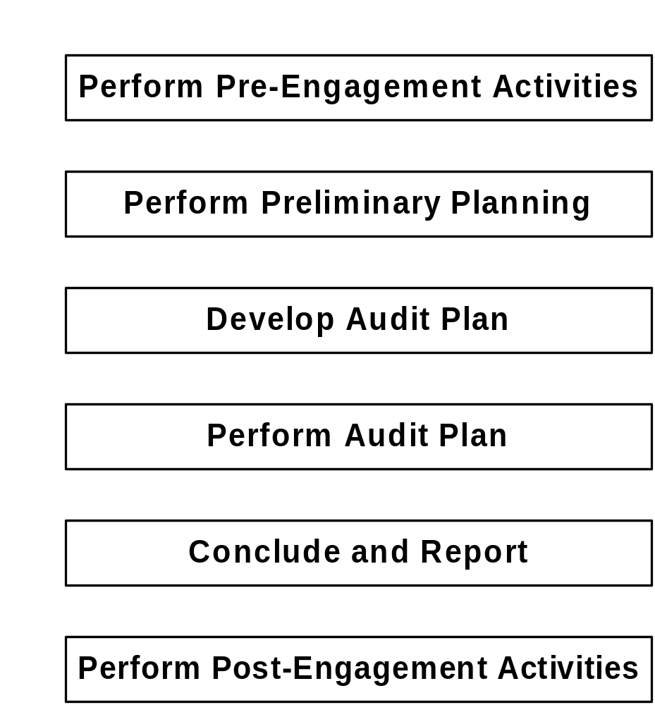
Audit Cycle
Notes:
Objective 2.2: Describe the major activities and attributes of AuditSystem/2.
Use the slide to introduce the six phases of the audit approach and to get participants to open up their audit manuals.
The audit approach has phases.
It must be used on all audit engagements.
It is cyclical, the audit process does not end, it is a rolling process.
At the assistant level, most time is spent on performing the audit plan, which is therefore the primary focus of this course.
It is important to understand the process and so time will be spent looking at a number of areas.
Direct participants to look inside the back cover of The Audit Approach manual and find the large fold out audit diagram. Ensure that they see the six phases of the audit approach on the left hand side of the chart.
Remind participants that many of the activities included in the diagram are continuous and often performed simultaneously.
Direct participants to look inside the front of the The Audit Approach manual and find the Table of Contents. Ensure that they see the linkage between the audit diagram and the chapters in the manual.
Direct participants to look inside the front of the The Audit Approach: Detailed Guidance manual and find the Table of Contents. Ensure that they see that this volume provides detailed guidance for most of the chapters in The Audit Approach manual.

Slide 78
Preliminary Planning
Understand the client’s business
Understand the control environment
Understand the accounting process
Perform preliminary analytical procedures
Determine planning materiality
Prepare and communicate client service plan
Notes:
Objective 2.2 continued
Use the slide to discuss preliminary planning activities.
During Preliminary Planning Activities we:
Obtain a knowledge of the client’s business sufficient to enable us to identify and understand the events, transactions and practices that, in our judgment, may have a significant impact on the audit engagement and financial statements.
Obtain an understanding of the control environment sufficient to assess the overall attitude, awareness, and actions of the directors and management regarding internal controls and their importance to the entity.
Obtain a high-level understanding of the accounting process sufficient to enable us to identify specific risks associated with the accounting process and to develop an appropriate audit plan.
Perform preliminary analytical procedures in planning our audit engagement to obtain a general understanding of the content of the financial statements and significant operational or accounting changes that may have occurred since the prior audit engagement.
Determine the amount of misstatement judged to be material in the financial statements on which we are reporting—the planning materiality for the engagement.
Develop client service objectives that will enable us to fulfill our professional responsibilities, satisfy our clients’ needs and exceed their expectations and prepare an appropriate client service plan to achieve these client service objectives.

Slide 79
Develop Audit Plan
Assess risk at the account balance and potential-error level
Plan tests of controls
Plan substantive tests
Summarize and communicate audit plan
Notes:
Objective 2.2 continued
Use the slide to discuss developing an audit plan.
Based on our assessment of engagement risk and specific identified risk(s) at the account balance and potential-error level, we design effective procedures to obtain reasonable assurance that misstatements arising from fraud and error that are material to the financial statements as a whole, either individually or in combination with others, are detected.
We do this by considering and developing a plan for each significant account balance and related potential errors.
We plan to perform appropriate combinations of tests of controls and substantive procedures to obtain the required audit assurance.
We summarize our audit plan by preparing an audit planning memorandum in order to:
Describe the expected scope and conduct of the audit engagement.
Highlight all significant issues and risks identified during our preliminary planning and risk assessment activities, and our decisions concerning reliance on controls.
Provide evidence that we have planned the audit engagement appropriately, and have responded to engagement risk, specific identified risks, and other matters affecting the audit engagement.

Slide 80
Perform Audit Plan
Perform tests of controls and evaluate results
Perform substantive tests and evaluate results
Perform financial statement review

Slide 81

Questions?

Slide 82
Thank You

